Slide 1
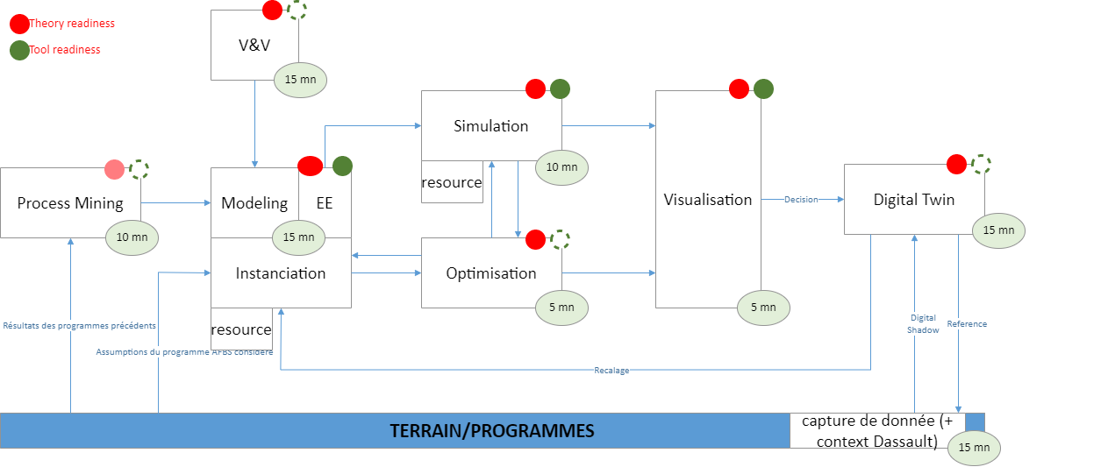
Etape 3: V&V de la logique de développement programme T4.x.x

Slide 2









OBP2: Semantical Diagnosis and Formal Verification
Model-checking
Omniscient Debugging
Multiverse Debugging
Semantic
Language
Interface
Langage independent
Vérification SE-LTL
Continuum debug - verification
Embedded execution monitoring
Semantic-based scheduling
Executable specifications
TLA+
AEFD
Fiacre
©2007-2022
Notes:
OBP est développé à l’ENSTA Bretagne
Ce model-checker permet de vérifier des propriétés exprimées en logique temporelle mais est aussi utilisé pour le débugging et dans le domaine de l’embarqué.
Le cœur est indépendant du langage.
Au fil des années et des partenariats, on a développé plusieurs plugins pour des langages comme …
Cette indépendance nous permet aussi, dans le cas de PragmaDev Process, d’utiliser OBP en mode « remote » comme back-end de vérifiation
Mais son rôle dans le projet est plus large

Slide 3
Requirement example
« Does `B` always happens after `A` in less than 3 weeks? »
PragmaDev Process allows for the verification of temporal formula but while it does support time for simulation purpose, it does not for the verification phase.
To answer this question, we thus need a new PDP interpreter that provides represents time in a precise but finite way (symbolic).
Notes:
Pour illustrer ce que l’on cherche à faire, un bon exemple de question à laquelle on cherche à répondre …
Il nous faut une brique logicielle dédiée où, en d’autres mots, un « plugin » OBP

Slide 4
Analyse de modèle PDP dans le cadre de ONEWAY
PDP model
PDP-specific properties (metrics)
interprets
compute
Timed PDP Interpreter
(symbolic)
PDP Monitors
Diagnosis Toolbox:
Debugger
Simulator
Profiler
Exec. Monitors
Model-checker
PDP Interpreter
SLI
SLI = Semantic Language Interface
Notes:
Actuellement, le modèle est interprété par PragmaDev Process pour permettre le debug, la simulation, le profiling et le model-checking.
Pour la vérification de modèles PDP temporisés, on a besoins d’une nouvelle brique …

Slide 5
Plan
Execution semantics
Time representation & semantics
Analysis of ONEWAY representative PDP model
Conclusion, ongoing and future work

Slide 6
PDP Execution semantics
Two semantics : Timed PDP & PragmaDev Process
Commonalities :
BPMN 2.0 standard compliant
Support all of ONEWAY meta model elements
(sequence flow, task, call activity, gateways, signal events, …)
Weakly bisimulable (if a property holds with a semantics, it holds with the other)
Differences :
Time representation : symbolic versus explicit
Semantics : big steps versus small steps
Notes:
Bisimulation, ce que ca veut dire, c’est que si une propriété est vérifiée dans un cas elle l’est aussi dans l’autre. Les deux sémantique sont « équival

Slide 7
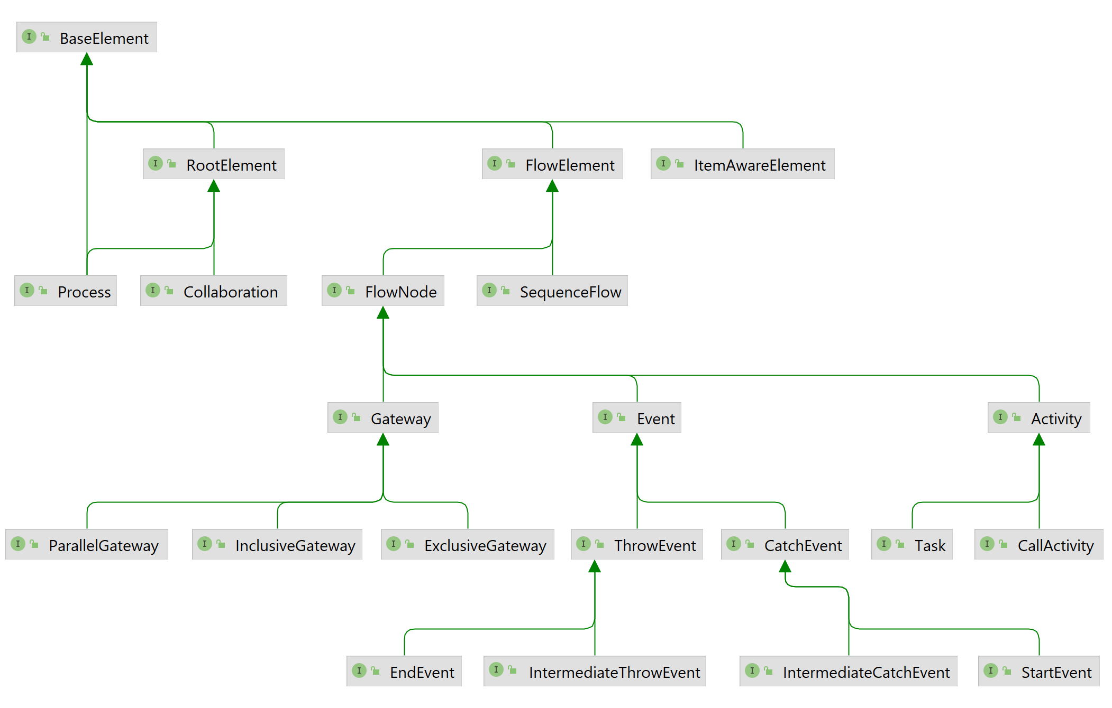
BPMN 2.0 Meta-Model (subset)
Root Element
Collaboration
Process
Flow Elements
Sequence Flow
Flow Node
Gateways
Events
Activities
Data
Item-Aware Elements

Slide 8

Execution Semantics – Tokens
« The behavior of process elements can be defined by describing how they interact with a token as it traverses the structure of the process. »
Similar to program pointer in the context of imperative programming
Places : Sequence flows (ex: 1 & 2) and simple Tasks (ex: DoSomething)
Notes:
Préciser la notion de pointeur de programme pour les non informaticiens?
Notion de token non nécessaire pour respecter le standard
Liens avec les proposition atomiques

Slide 9
Execution Semantics – Tokens
{ }
{ 2 }
{ 1 }
{ DoSomething }

Slide 10
Execution Semantics – Tokens
An execution starts with tokens on sequence flows outgoing from participants’ (root process(es)) unconditional start events
An execution ends properly if no tokens are left
{ 1 } → { DoSomething } → { 2 } → { }
Notes:
Bien introduire la notion de configuration
Evoquer la différence avec PragmaDev Process

Slide 11
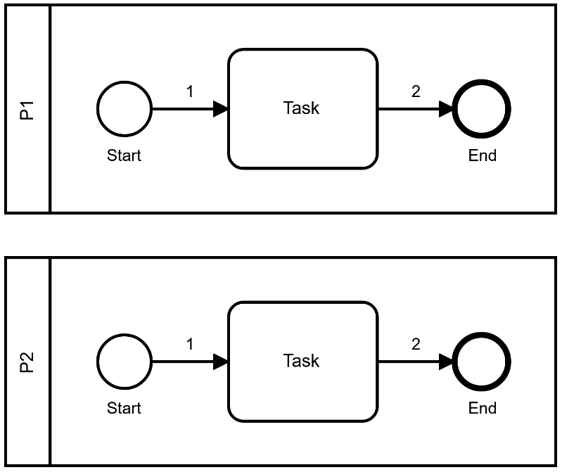
Execution Semantics – Collaboration
{ P1@1 P2@1 }
{ P1@T P2@1 }
{ P1@1 P2@T }
{ P1@2 P2@1 }
{ P1@T P2@T }
{ P1@1 P2@2 }
{ P2@1 }
{ P1@2 P2@T }
{ P1@T P2@2 }
{ P1@1 }
{ P2@T }
{ P1@2 P2@2 }
{ P1@T }
{ P2@2 }
{ P1@2 }
{ }
Notes:
Fenêtre sur le model-checking
Si j’ai le temps, rajouter les tokens lors de l’animation

Slide 12
Execution Semantics – Gateways
Parallel :
Activated if there is at least one token on each incoming flows
Consumes exactly one token from each incoming flows (join)
Produces exactly one token at each outgoing flows (fork)
Exclusive (with exactly one outgoing flow) :
Activated if there is at least one token on one incoming flow
Consumes exactly one token from one incoming flow
Produces exactly one token at its one outgoing flow

Slide 13
Execution Semantics – Gateways
Inclusive :
Binds subsets of incoming flows to subsets of outgoing flows
All conditions that evaluate to true yield a token on their flows
Both rely on conditions attached to outgoing flows
Exclusive (with multiple outgoing flows) :
Each activation, produces at most one token
Conditions are evaluated in order, the first condition that evaluates to true yield a token on its flow

Slide 14
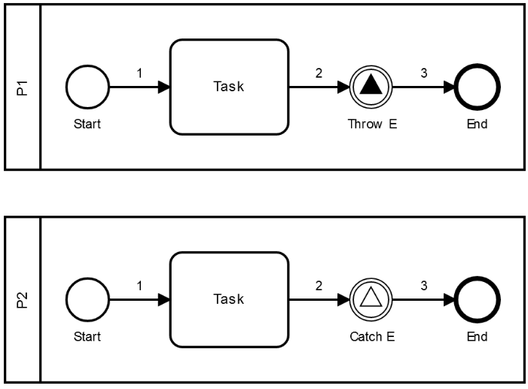
Execution Semantics – Signals
A throw event activates when there is a token on its incoming flow
A catch event activates when there is a token on its incoming flow and a matching throw event activates
Consumes one token from the throw event incoming flow and all tokens on matching catch events incoming flows
Produces one token at the throw event outgoing flow and as many tokens as consumed at matching catch events outgoing flows
Start (resp. End) events can also catch (resp. throw)
Notes:
Stick to the intuition (more slides on the subject follow)

Slide 15
Execution Semantics – Signals
Participant P2 reaches 2 soon enough :
… → { P1@2 P2@2 } → { P1@3 P2@3 } → … → { }
Can lead to deadlocks (a catch event may never activate with a token on its incoming flow)
Participant P1 throws its event too early (deadlock) :
… → { P1@2 P2@T } → { P1@3 P2@T } → … → { P2@2 }

Slide 16
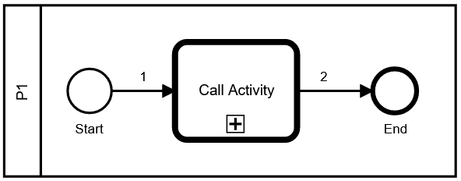
Execution Semantics – Call Activity
References a process to be executed upon activation (if not, behaves like a simple task)
When entered, consumes one token from one of its incoming flows
When entered, produces on token on flows following a start event within the called process
Tokens within a called process are also identified by their call activity (stack trace)
When the called process ends, produces a token at each of the call activity outgoing flows

Slide 17
Sémantique d’exécution : Exemple
{ P1@1 P2@1 }
{ P1@T P2@1 }
{ P1@1 P2@T }
{ P1@2 P2@1 }
{ P1@T P2@T }
{ P1@1 P2@2 }
{ P2@1 }
{ P1@2 P2@T }
{ P1@T P2@2 }
{ P1@1 }
{ P2@T }
{ P1@2 P2@2 }
{ P1@T }
{ P2@2 }
{ P1@2 }
{ }

Slide 18
Plan
Execution semantics
Time representation & semantics
Analysis of ONEWAY representative PDP model
Conclusion, ongoing and future work

Slide 19
Meta Model Extension – Timed Constraints
Attached to tasks
Provided (so far) as constants or triangular distributions with values for minimum, maximum and mode (denotes the most likely outcome)
Exemple : min = 29, max = 43, mode = 36
0
29
36
43

Slide 20
Meta Model Extension – Timed Constraints
For non-probabilistic reachability concerns, mode is irrelevant
Thus, constraints can be represented as intervals
If min <> max, a triangular distribution excludes its bounds (P(t) = 0)
Ex : [5, 5] (from a constant) & ]29, 43[ (from a triangular distribution)
0
29
36
43
Notes:
i.e. analyse au pire cas

Slide 21
Timed Execution Semantics – Intuition
]1, 2[
Execution :
Initial configuration : { 1 } , elapsed : [0, 0]
Task active : { T } , elapsed : [0, 2[
Task closed : { 2 } , elapsed : ]1, 2[
Process finished : { } , elapsed : ]1, oo[
Generic rules:
If a sequence flow can be traversed, time is frozen
A task can be active up to its maximum
( upper bound may increase when tasks are active )
A task can not end before its minimum is reached
( lower bound may increase when a task closes )

Slide 22
Timed Execution Semantics – Collaboration
Configurations :
Elapsed time :
{ P1@1 P2@1 }
[0, 0]
{ P1@T P2@1 }
{ P1@1 P2@T }
]1, 2[
[0, 2[
{ P1@T P2@T }
{ P1@2 P2@T }
{ P1@T P2@2 }
]1, 2[
{ P2@T }
{ P1@2 P2@2 }
{ P1@T }
]1, 2[
{ P2@2 }
{ P1@2 }
{ }
]1, oo[

Slide 23
Timed Execution Semantics – Gateways & Events
If a sequence flow can be traversed, time is frozen
Corollary : if no sequence flow can be traversed, time may advance
Parallel gateway : if an incoming flow is missing, time may advance regardless of tokens on other incoming flows to that gateway
Events : If a signal can not be thrown, time may advance regardless of tokens on incoming flows to matching catch events

Slide 24
Timed Execution Semantics – Gateways & Events
Configurations :
Elapsed time :
{ P1@1 P2@1 }
[0, 0]
{ P1@T P2@1 }
{ P1@1 P2@T }
]3, 4[
{ P1@T P2@T }
[0, 2[
{ P1@T P2@2 }
]1, 4[
{ P1@2 P2@2 }
]3, 4[
{ P1@3 P2@3 }
]1, 2[
{ P2@3 }
{ P1@3 }
{ }
]3, oo[

Slide 25
Timed Execution Semantics – Gateways & Events
Configurations :
Elapsed time :
{ P1@1 P2@1 }
[0, 0]
{ P1@T P2@1 }
{ P1@1 P2@T }
]1, 2[
{ P1@T P2@T }
[0, 2[
{ P1@2 P2@T }
]1, 2[
{ P1@3 P2@T }
{ P2@T }
]1, 4[
]3, 4[
{ P2@2 }
]3, oo[
Notes:
By the end, introduce next slide (global elapsed time not sufficient nor necessary to decide what happens next)

Slide 26
Timed Execution Semantics – Clocks
Global elapsed time is not sufficient to decide what happens next
Instead:
A clock is defined for each active token, it tells how long its token has been present
When time changes, it does so evenly for all clocks
For the abstraction to be precise, we also need to keep track of the differences between clocks

Slide 27
Timed Execution Semantics – Clocks
Ex : ( { P1@T P2@T } , { c0:[0, 2[ , c1:[0, 2[ , c1-c0:[0,0] } )
{ P1@T P2@T } : the set of tokens
c0:[0, 2[ , c1:[0, 2[ : for each token, the time elapsed since present
c1-c0:[0,0] : for each two tokens, the time difference
[0, 0] : c0 and c1 are equal
[1, 1] : c1 is greater than c0 by exactly 1 time unit
[n, m] : difference of at least n and at most m time units

Slide 28
Timed Execution Semantics – DBM
Ex : ( { P1@T P2@T } , { c0:[0, 2[ , c1:[0, 2[ , c1-c0:[0,0] } )
P2@T
 |  | P1@T | P2@T
 |  | < 2 | < 2
P1@T | >= 0 |  | <= 0
P2@T | >= 0 | >= 0
2
Difference Bound Matrix
(DBM)
0
2
P1@T

Slide 29
Timed Execution Semantics – DBM
Ex : ( { P1@T P2@T } , { c0:[0, 2[ , c1:[0, 2[ , c1-c0:[0,1[ } )
P2@T
 |  | P1@T | P2@T
 |  | < 2 | < 2
P1@T | >= 0 |  | < 1
P2@T | >= 0 | >= 0
2
Difference Bound Matrix
(DBM)
0
2
P1@T

Slide 30
Difference Bounded Matrix – Execution Step
How to update the DBM given a model, a source configuration, a transition :
Minimum bounds are updated according to the transition’s guard (when a task closes, the minimum time this task needs to be active)
Clocks of consumed tokens are removed, clocks are introduced for each produced tokens (hence, if a token moves, its clock is reset)
Maximum bounds are updated according to the target’s invariant (how much can time advance given the set of tokens and current valuation of clocks)

Slide 31
Timed Verification & Properties
Timed constraints restrict possible executions, thus a property that fails without these may now hold (ex: events & deadlock)
New atomic propositions :
Global elapsed time (ex: TTM < 42)
Elapsed time between two observable events (ex: a token appears, a process starts, a task closes, a signal is thrown, …)
Temporal logic
Atomic propositions
Dwyers Patterns

Slide 32
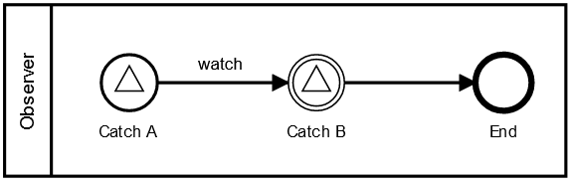
Timed Verification & Properties
Req : « Signal B must answer to A in less than 21 time units »
Generated observer :
(intuition using BPMN)
Generated property : [] | c_watch < 21 |
With:
« [] … » the temporal formula
« | c_watch < 21 | » an atomic proposition
« c_watch » the clock associated to « watch » sequence flow
Notes:
Before displaying the observer:
Time elapsed between two events is not part of the basic configuration, we need to introduce a new clock to track the time referenced by the proposition.

Slide 33
Plan
Execution semantics
Time representation & semantics
Analysis of ONEWAY representative PDP model
Conclusion, ongoing and future work

Slide 34
ONEWAY representative model : metrics
Structural metrics
33 BPMN processes
3584 sequence flows, 362 gateways
958 activities including 32 call activities
475 different signals
Exploration metrics
Up to 653 tokens at a given state
Up to 59 possible actions (enabled parallel tasks)
« Optimistic » estimation of the state space : 10^28
Notes:
La taille de l’espace d’état grossit exponentiellement avec le nombre de tâches parallèles.

Slide 35
A BPMN specific symmetry reduction
Intuition : Fold unnecessary steps in between 2 tasks
Considerably reduce the size of the state space while preserving executions
Estimated gain : 2/3 of the original order of magnitude (from 10^28 to 10^18)
Example : 12 parallel tasks (« process 0 »)
State space before reduction: 531 442
State space after reduction : 4 097
Before reduction : 6 of 33 processes (18%) have less than 1 000 000 states
After reduction : 22 of 33 processes (67%) have less than 1 000 000 states

Slide 36
Symmetry reduction : Example
{ P1@1 P2@1 }
4 states versus 16 before reduction
{ P1@T P2@1 }
{ P1@1 P2@T }
{ P1@2 P2@1 }
{ P1@T P2@T }
{ P1@T P2@T }
{ P1@1 P2@2 }
{ P2@1 }
{ P1@2 P2@T }
{ P1@T P2@2 }
{ P1@1 }
{ P1@T }
{ P2@T }
{ P1@T }
{ P2@T }
{ P1@2 P2@2 }
{ P2@2 }
{ P1@2 }
{ }
{ }

Slide 37
Plan
Execution semantics
Time representation & semantics
Analysis of ONEWAY representative PDP model
Conclusion, ongoing and future work

Slide 38
Conclusion
A new timed PDP semantics
BPMN 2.0 standard compliant
Symbolic representation of time
Successfully loads ONEWAY representative model, produces execution metrics
Towards scaling the analysis
Allows for the exploration of specific processes in isolation
BPMN specific symmetry reduction

Slide 39
Ongoing & future work
From requirements to temporal and timed properties
Identification of a common vocabulary for analysis activities
Make properties accessible to business experts
More towards scaling the analysis
Other BPMN specific optimisations
Model specific optimisations
Where possible, reduce parallelism
Algorithmic dedicated to acyclic models
Partial exploration (Amnesiac Oxen)
Capitalisation over timed aspects and integration opportunities with PragmaDev PDP simulation toolkit
Notes:
Allignement entre les primitives de propriétés et l’expression métier

